Slide 1
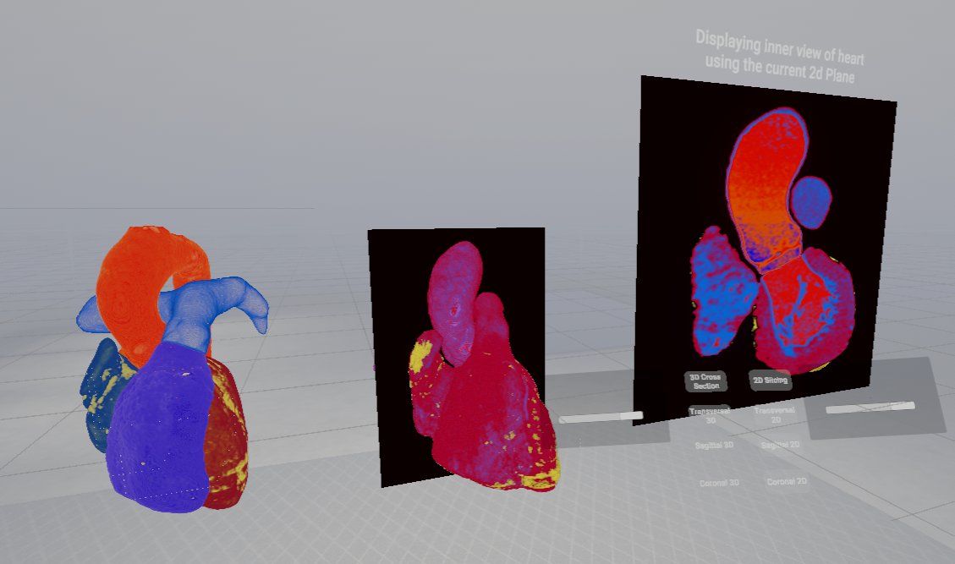
Heart Anatomy Learning Tool
Innovation Lab 2 SS2025 group 16

Slide 2
Project: group 16
Gössl Marcel if23b093@technikum-wien.at (Product Owner)
Hadinger Felix if23b079@technikum-wien.at (Scrum Master)
Salem Karim if22b240@technikum-wien.at
Marek Simon if23b111@technikum-wien.at

Slide 3
Projectidea
Development of an interactive VR learning tool for anatomy
Visualization of a human heart (based on DICOM data)
A set of tools for detailed exploration of cardiac structures

Slide 4

Goals (WS2024/25)
Rendering of DICOM images
Zoom & rotation of the heart via hand-tracking
Color-coded display of anatomical structures
2D views in the standard anatomical planes
Interactive insight into internal chambers & vessels
Labelling for all visible components
Integrated quiz mode for self-assessment

Slide 5
Goals (SS2025)
Rendering of DICOM images
Zoom & rotation of the heart via hand-tracking
Color-coded display of anatomical structures
2D views in the standard anatomical planes
Interactive insight into internal chambers & vessels
Labelling for all visible components
Integrated quiz mode for self-assessment

Slide 6
Tools
Version control: Unity Version Control; GitHub (for organisational documents)
Project management: Trello
Communication: Discord, WhatsApp, and in-person meetings

Slide 7
Trello projectmanagement
Backlog Workflow:
Pre-sprint: Prioritize and select items for the upcoming sprint
Item details: Status (To Do, In Progress, Done), Priority (High/Medium/Low), Sprint assignment
Sprint start: Team members choose tasks → assignees set
Post-sprint: Update item statuses, complete sprint review, plan next sprint

Slide 8
Retrospective - Challenges
Include buffer time for unexpected bugs/issues
Place greater emphasis on testing
Address version control issues (especially with scripts)
Avoid bottlenecks in the workflow

Slide 9
Results
Unity project
Heart segmentation with accurate coloring
3D plus 2D views (transverse, sagittal, coronal planes)
UI for all functions
Experience base for future semesters
Unity Version Control for source/assets
3D Slicer (program) to generate the heart segments (DICOM)
Custom Unity scripts and UI components

Slide 10
Live demo
Innovation Lab 2 2025 group 16
Notes:
wird mein Kollege nun direkt im Programm herzeigen…

